Slide 1

Hunger in America
Ann Rumsey

Slide 2
Capstone project
Link to Git Hub
Link to Power BI
Link to Tableau

Slide 3
Hunger in America – content & methods
Tools used: Python, Tableau, Excel, and Power BI (correlation plot R package)
Source data sets are from the USDA (United States Department of Agriculture)
SNAP - Supplemental Nutrition Assistance Program
USDA Food & Nutrition Service Child Nutrition and Food expenditures
US Census tract data and 2010 population
PSA: Return your 2020 Census form! (*national rate of return 61.6% on 18-Jun-2020)

Slide 4
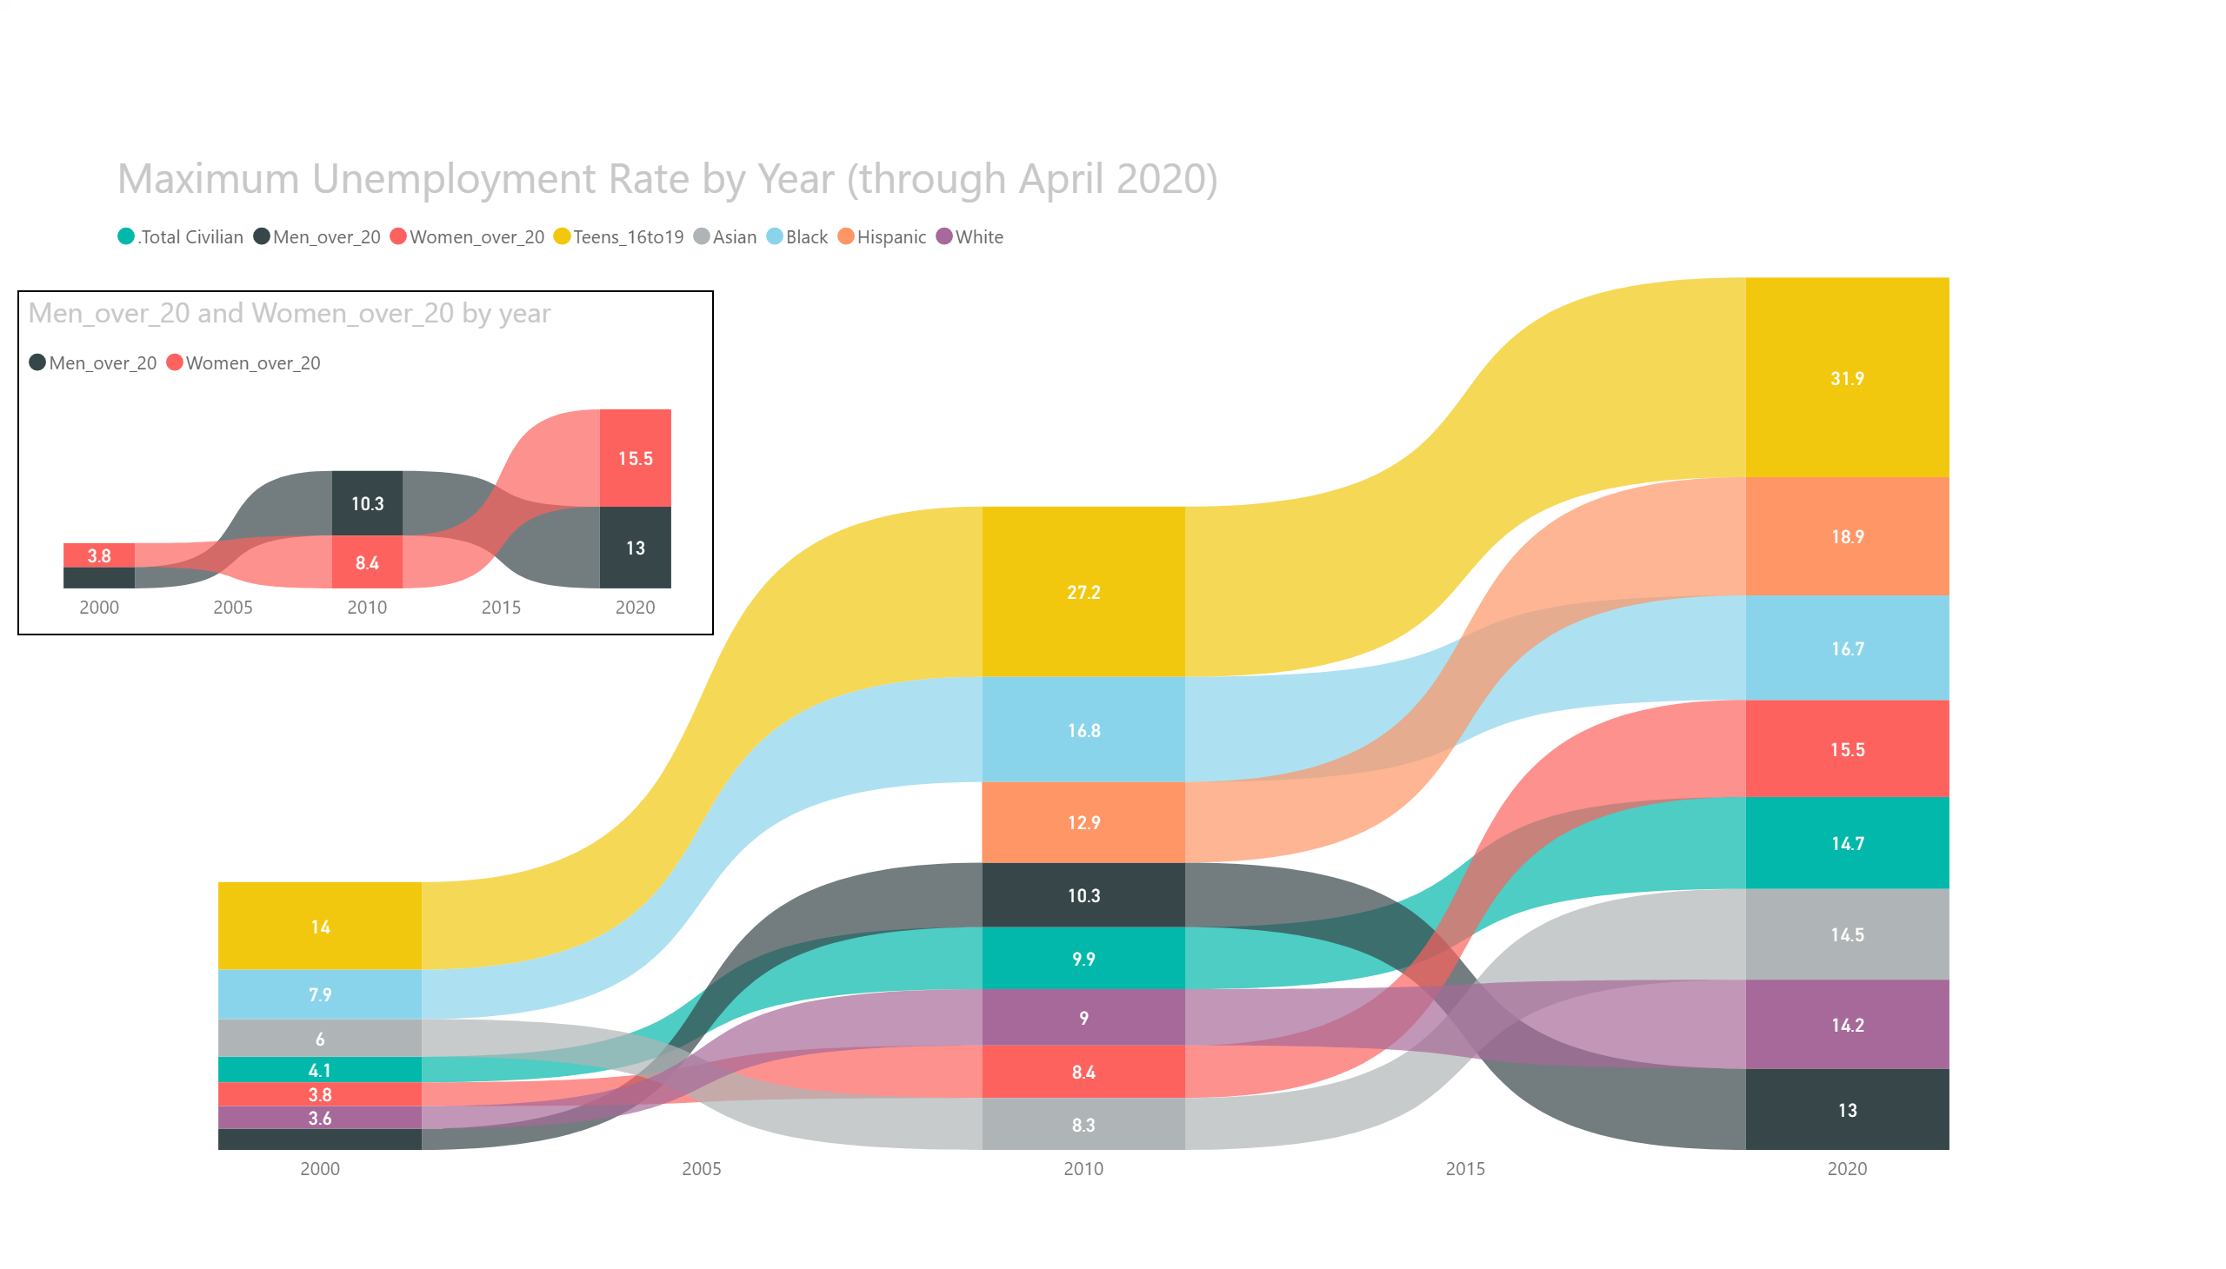
Notes:
Unemployment trends 2000 to April 2020
Demographic ribbons
Men vs. Women over 20 and Teens
Interactive trends and rank

Slide 5
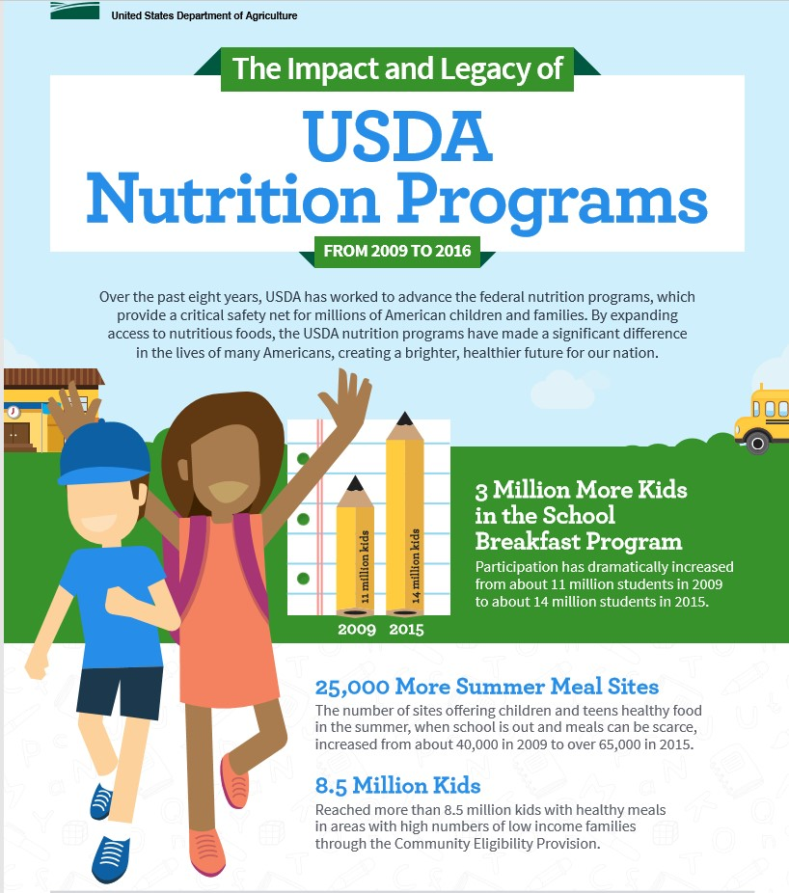
Food Security
The first National Food Stamp program was established in 1939 to combat hunger during high unemployment
"We got a picture of a gorge, with farm surpluses on one cliff and under-nourished city folks with outstretched hands on the other. We set out to find a practical way to build a bridge across that chasm." Milo Perkins, the Food Stamp program’s first administrator
Today:
The United States federal government through the USDA - Department of Agriculture, supports Farmers and the Nutritional needs of children and adults through several meal programs that take advantage of fresh food and dairy products.

Slide 6
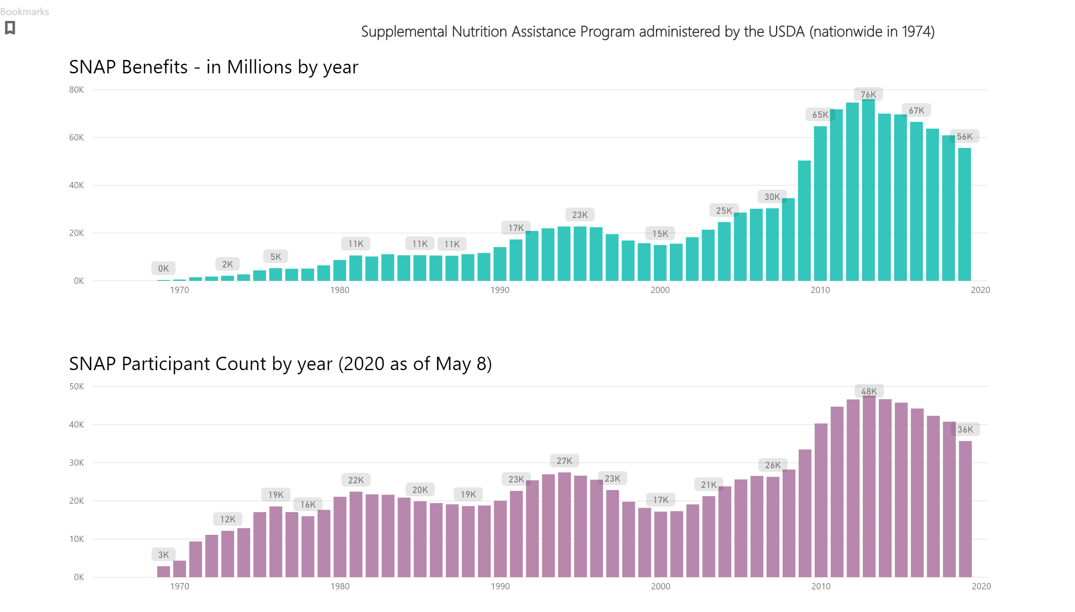
Notes:
Participant Counts by year 1970-April 2020 (National in 1974)
Average Monthly Benefits per person
Total Benefit dollars in Millions
Administrative Cost percent (includes state administrative fees)

Slide 7
USDA Food and Nutrition Service Federally assisted food programs
School Lunch program (NSLP) established in 1946, with the National School Lunch Act providing nutritionally balanced, low-cost or free lunches to children each school day in public and nonprofit private schools and residential childcare institutions
School Breakfast Program (SBP) provides reimbursement to states to operate nonprofit breakfast programs in schools and residential childcare institutions.
The Child and Adult Care Food Program (CACFP) is a federal program that provides reimbursements for nutritious meals and snacks to eligible children and adults who are enrolled for care at participating childcare centers, day care homes, and adult day care centers.
The Special Milk Program (SMP) provides milk to children in schools and childcare institutions who do not participate in other federal meal service programs.
From <https://www.fns.usda.gov/cn>

Slide 8
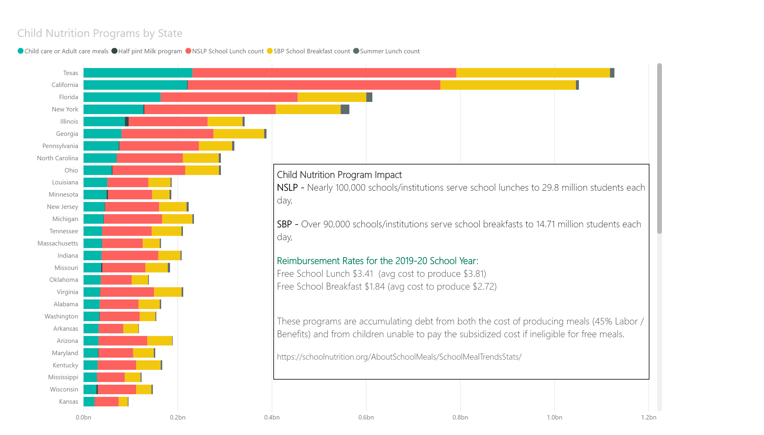

Slide 9
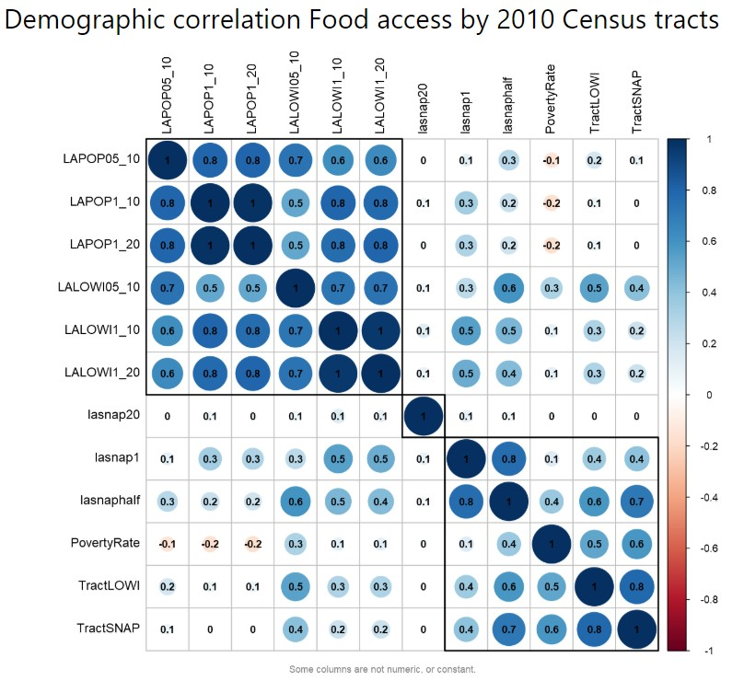
Levels of distance from a Supermarket
Low Access Census Tracts
General Population Count and
Low Income Population Count
Any distance from Food source
Poverty Rate
Low Income
SNAP Recipients
Housing units one mile
Housing units half mile
Field | LongName | Description
LAPOP1_10 | Low access, population at 1 mile for urban areas and 10 miles for rural areas, number | Population count beyond 1 mile for urban areas or 10 miles for rural areas from supermarket
LAPOP05_10 | Low access, population at 1/2 mile for urban areas and 10 miles for rural areas, number | Population count beyond 1/2 mile for urban areas or 10 miles for rural areas from supermarket
LAPOP1_20 | Low access, population at 1 mile for urban areas and 20 miles for rural areas, number | Population count beyond 1 mile for urban areas or 20 miles for rural areas from supermarket
LALOWI1_10 | Low access, low-income population at 1 mile for urban areas and 10 miles for rural areas, number | Low income population count beyond 1 mile for urban areas or 10 miles for rural areas from supermarket
LALOWI05_10 | Low access, low-income population at 1/2 mile for urban areas and 10 miles for rural areas, number | Low income population count beyond 1/2 mile for urban areas or 10 miles for rural areas from supermarket
LALOWI1_20 | Low access, low-income population at 1 mile for urban areas and 20 miles for rural areas, number | Low income population count beyond 1 mile for urban areas or 20 miles for rural areas from supermarket
lapophalf | Low access, population at 1/2 mile, number | Population count beyond 1/2 mile from supermarket
lasnap1 | Low access, housing units receiving SNAP benefits at 1 mile, number | Housing units receiving SNAP benefits count beyond 1 mile from supermarket

Slide 10
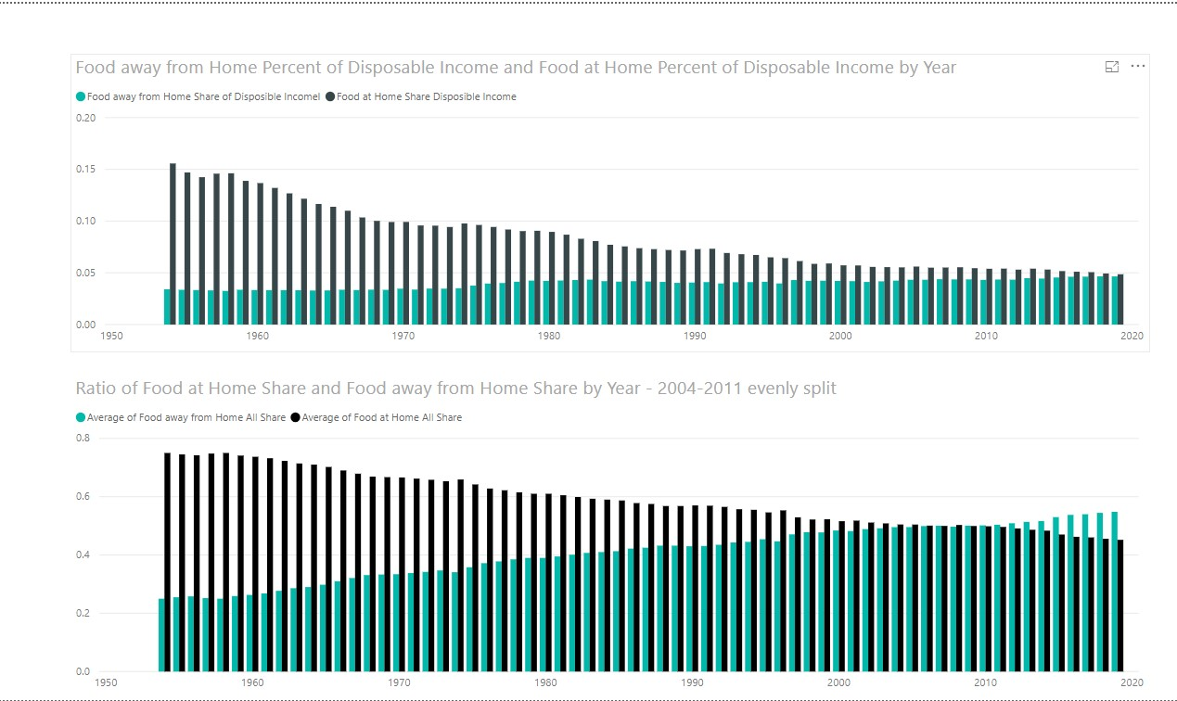

Slide 11
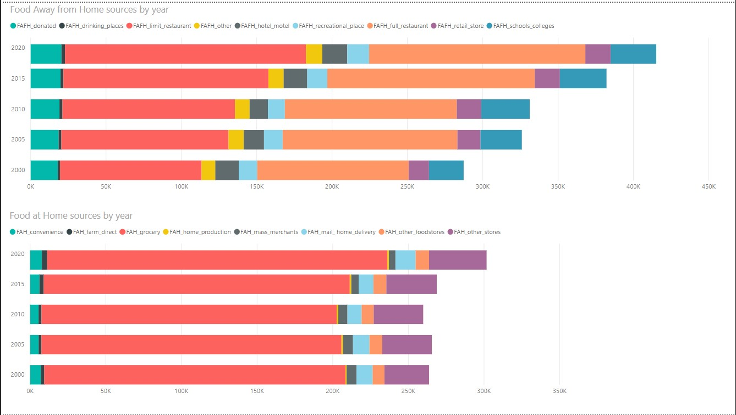

Slide 12
Sources, further research
Food access https://www.ers.usda.gov/data-products/food-access-research-atlas/download-the-data/
SNAP https://www.fns.usda.gov/pd/supplemental-nutrition-assistance-program-snap
Food security & safety https://www.fns.usda.gov/research-analysis
Food expenditures https://www.ers.usda.gov/data-products/food-expenditure-series/
School Lunch https://www.fns.usda.gov/pd/child-nutrition-tables
WIC - Women Infants Children https://www.fns.usda.gov/wic/frequently-asked-questions-about-wic
GE crops https://www.ers.usda.gov/webdocs/DataFiles/47649/alltablesGEcrops.csv?v=6372.6
US Census data: https://data.census.gov/cedsci/
Census response rate by day https://2020census.gov/en/response-rates.html
Used for US Population Forecast population through 2050 – web scraping technique used: https://www.worldometers.info/world-population/us-population/

Slide 13
1982 First GMO Human Insulin
the
future
of food
1994 First GMO Plant Tomato
1987 Initial discovery of CRISPR
2015 First GMO Meat - Salmon
2022 Bioengineered Food labels
2019 FDA deactivation of an import alert on genetically engineered salmon
2021 CRISPR potential for COVID-19
CRISPR-Cas9 is a method for quickly and accurately editing the genome of virtually any living thing. Using custom-built guide RNA paired with a cutting enzyme (Cas9), it can find and snip a selected sequence of DNA or RNA, eliminating or replacing a “bad” gene. Since it was first described, in late 2012, CRISPR has drastically accelerated the scope of research and moved into practical applications in medicine. So far in 2020, there are 15 trials underway. In medicine, where new drugs take a decade or more to develop, that’s game changing.
From <https://geneticliteracyproject.org/2020/06/12/infographic-what-crispr-is-curing-in-2020/>

Slide 14
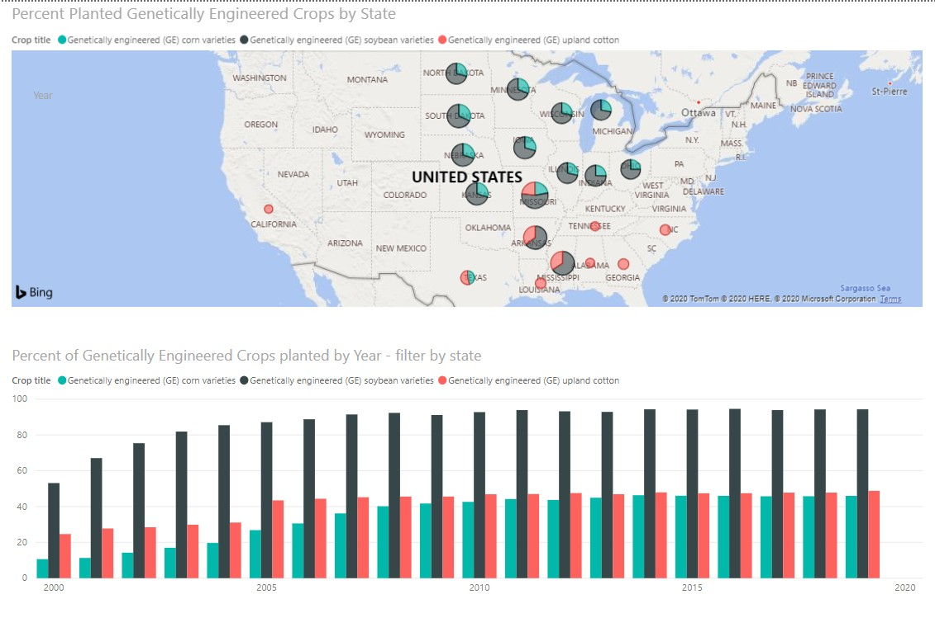
Future study Food Supply and Nutrition The fight against hunger in the United States will be impacted by the availability of nutritious foods for reasonable costs. Genetically engineered crops in the US – 2000 to 2019 GE varieties of corn, soybeans and cotton are genetically modified to enhance nutrition, increase production, and reduce waste due to pests or transportation. New manufacturing techniques give plant-based “burgers” a taste more closely resembling real meat. https://www.ers.usda.gov/topics/farm-practices-management/biotechnology/

Slide 15
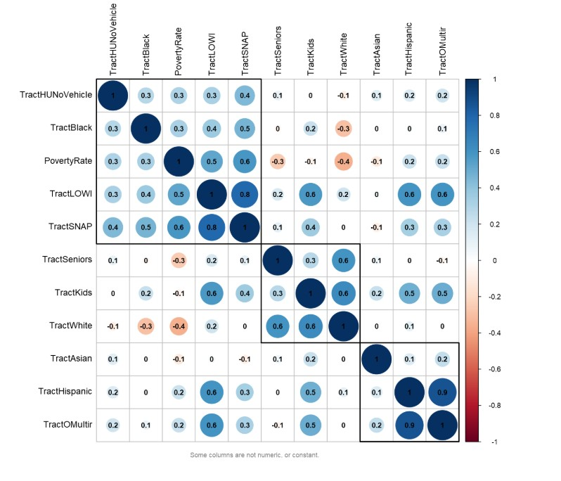
Demographics from the 2010 Census
The 2020 Census is in progress and VERY important for food funding. In Power BI using an R package this interactive chart shows *National and by *State correlation between Census tract populations:
LOWI (low income) &
SNAP (supplemental Nutrition Benefit recipients

Slide 16
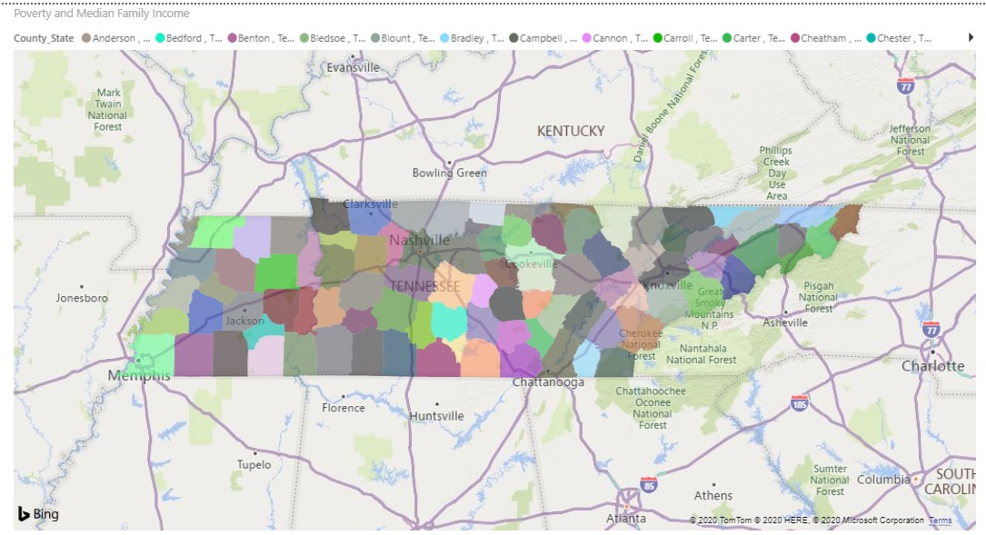
Poverty and Median Family Income
Filter by State
Tennessee
County level

